Slide 1


Impact of Science Conference the Parallel Session on:
Research Infrastructure and Mega-science
23rd June, 2021

Slide 2
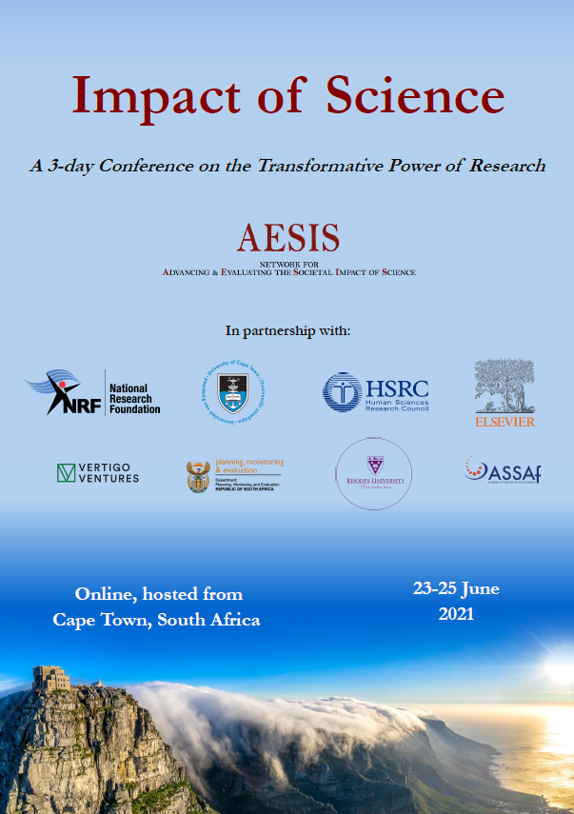

Impact of Science
23-25 June, 2021
Overview of the Speakers
Reiner Kruecken (Chair): Deputy Director of Research at TRIUMF, Canada’s Particle Accelerator Centre, Canada
Adrian Tiplady: Deputy Managing Director: Strategy & Partnerships, South African Radio Astronomy Observatory (SARAO), South Africa
Zeblon Vilakazi: Vice Chancellor of Wits University, South Africa
#IOS21

Slide 3
Impact of Science
23-25 June, 2021
Reiner Kruecken
Deputy Director of Research at TRIUMF, Canada’s Particle Accelerator Centre, Canada
#IOS21

Slide 4
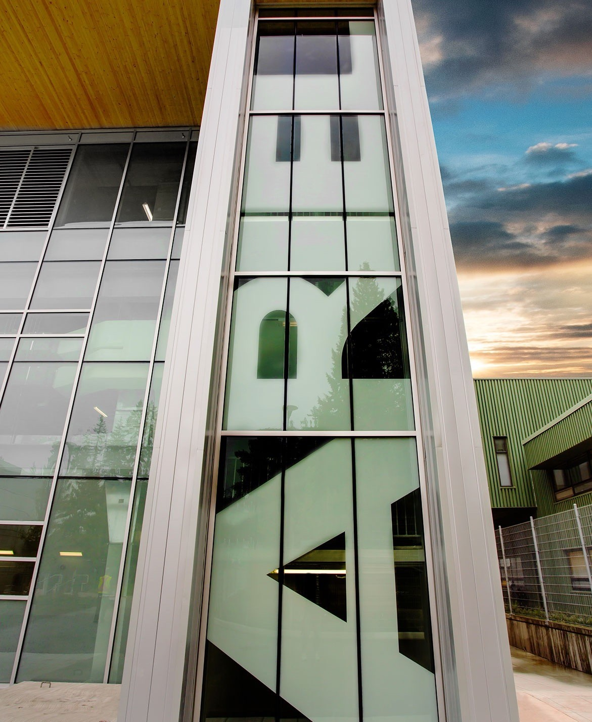

Impact of
Research Infrastructures on Society
Reiner Krücken
Deputy Director Research, TRIUMF
Professor of Physics, The University of British Columbia
AESIS Impact of Science Conference – June 2021
Discovery, accelerated

Slide 5
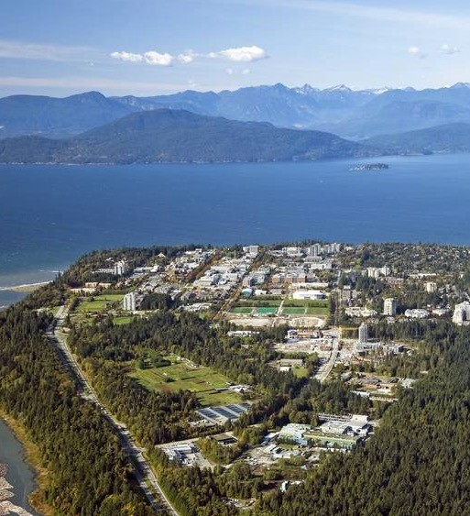
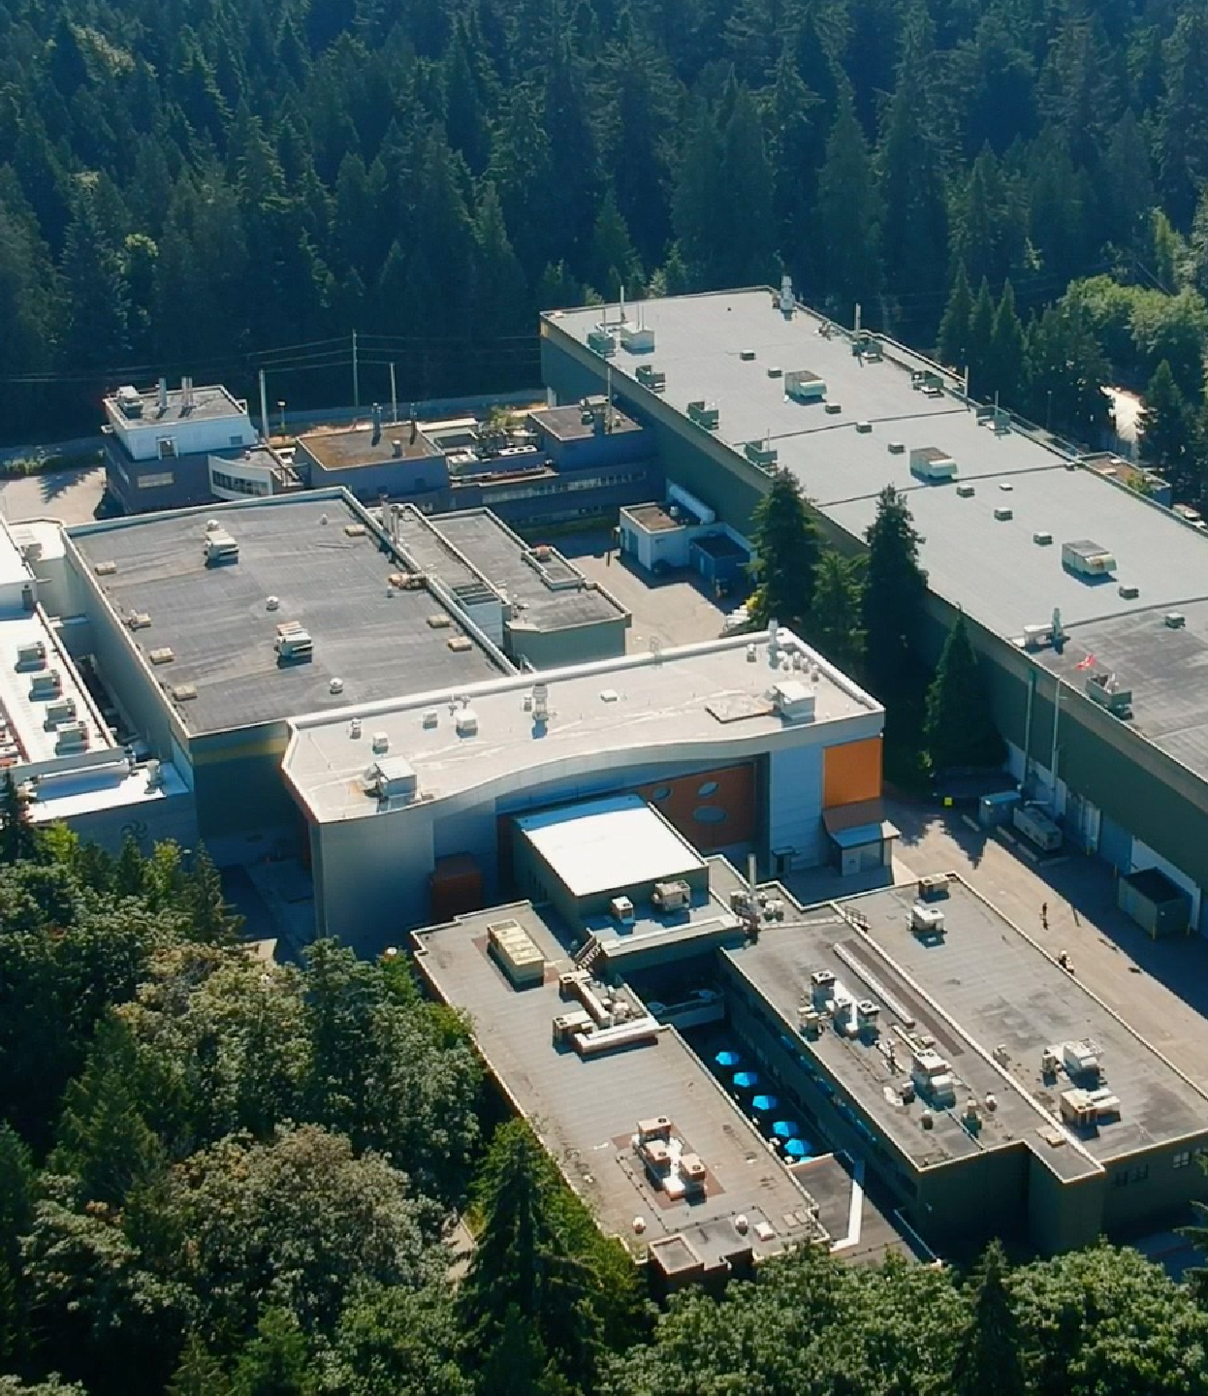

Our vision is for Canada to lead in science, discovery, and innovation, improving lives and building a better world.
Founded in 1968 to do research at a scale that no university can do on its own
Home to ~600 staff and students from 30 countries
> 200 students & post-doctoral researchers
TRIUMF is Canada’s particle accelerator centre
We advance isotope science and technology, both fundamental and applied.
We collaborate across communities and disciplines, from nuclear and particle physics to the life and material sciences.
We discover and innovate, inspire and educate, creating knowledge and opportunity for all.

Slide 6
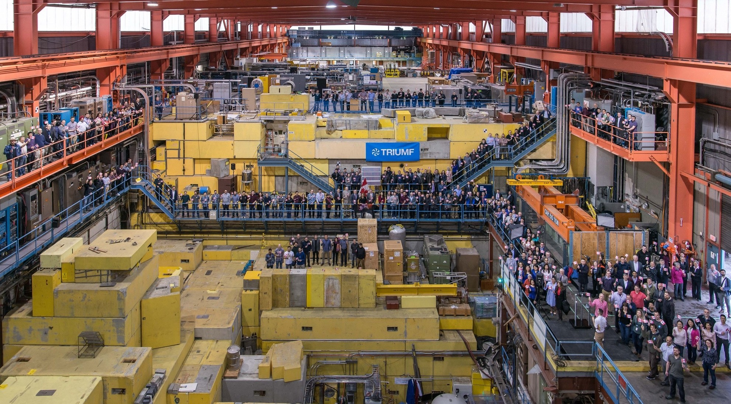
Infrastructure at a scale that no single university can realize on its own
World’s Largest Cyclotron

Slide 7
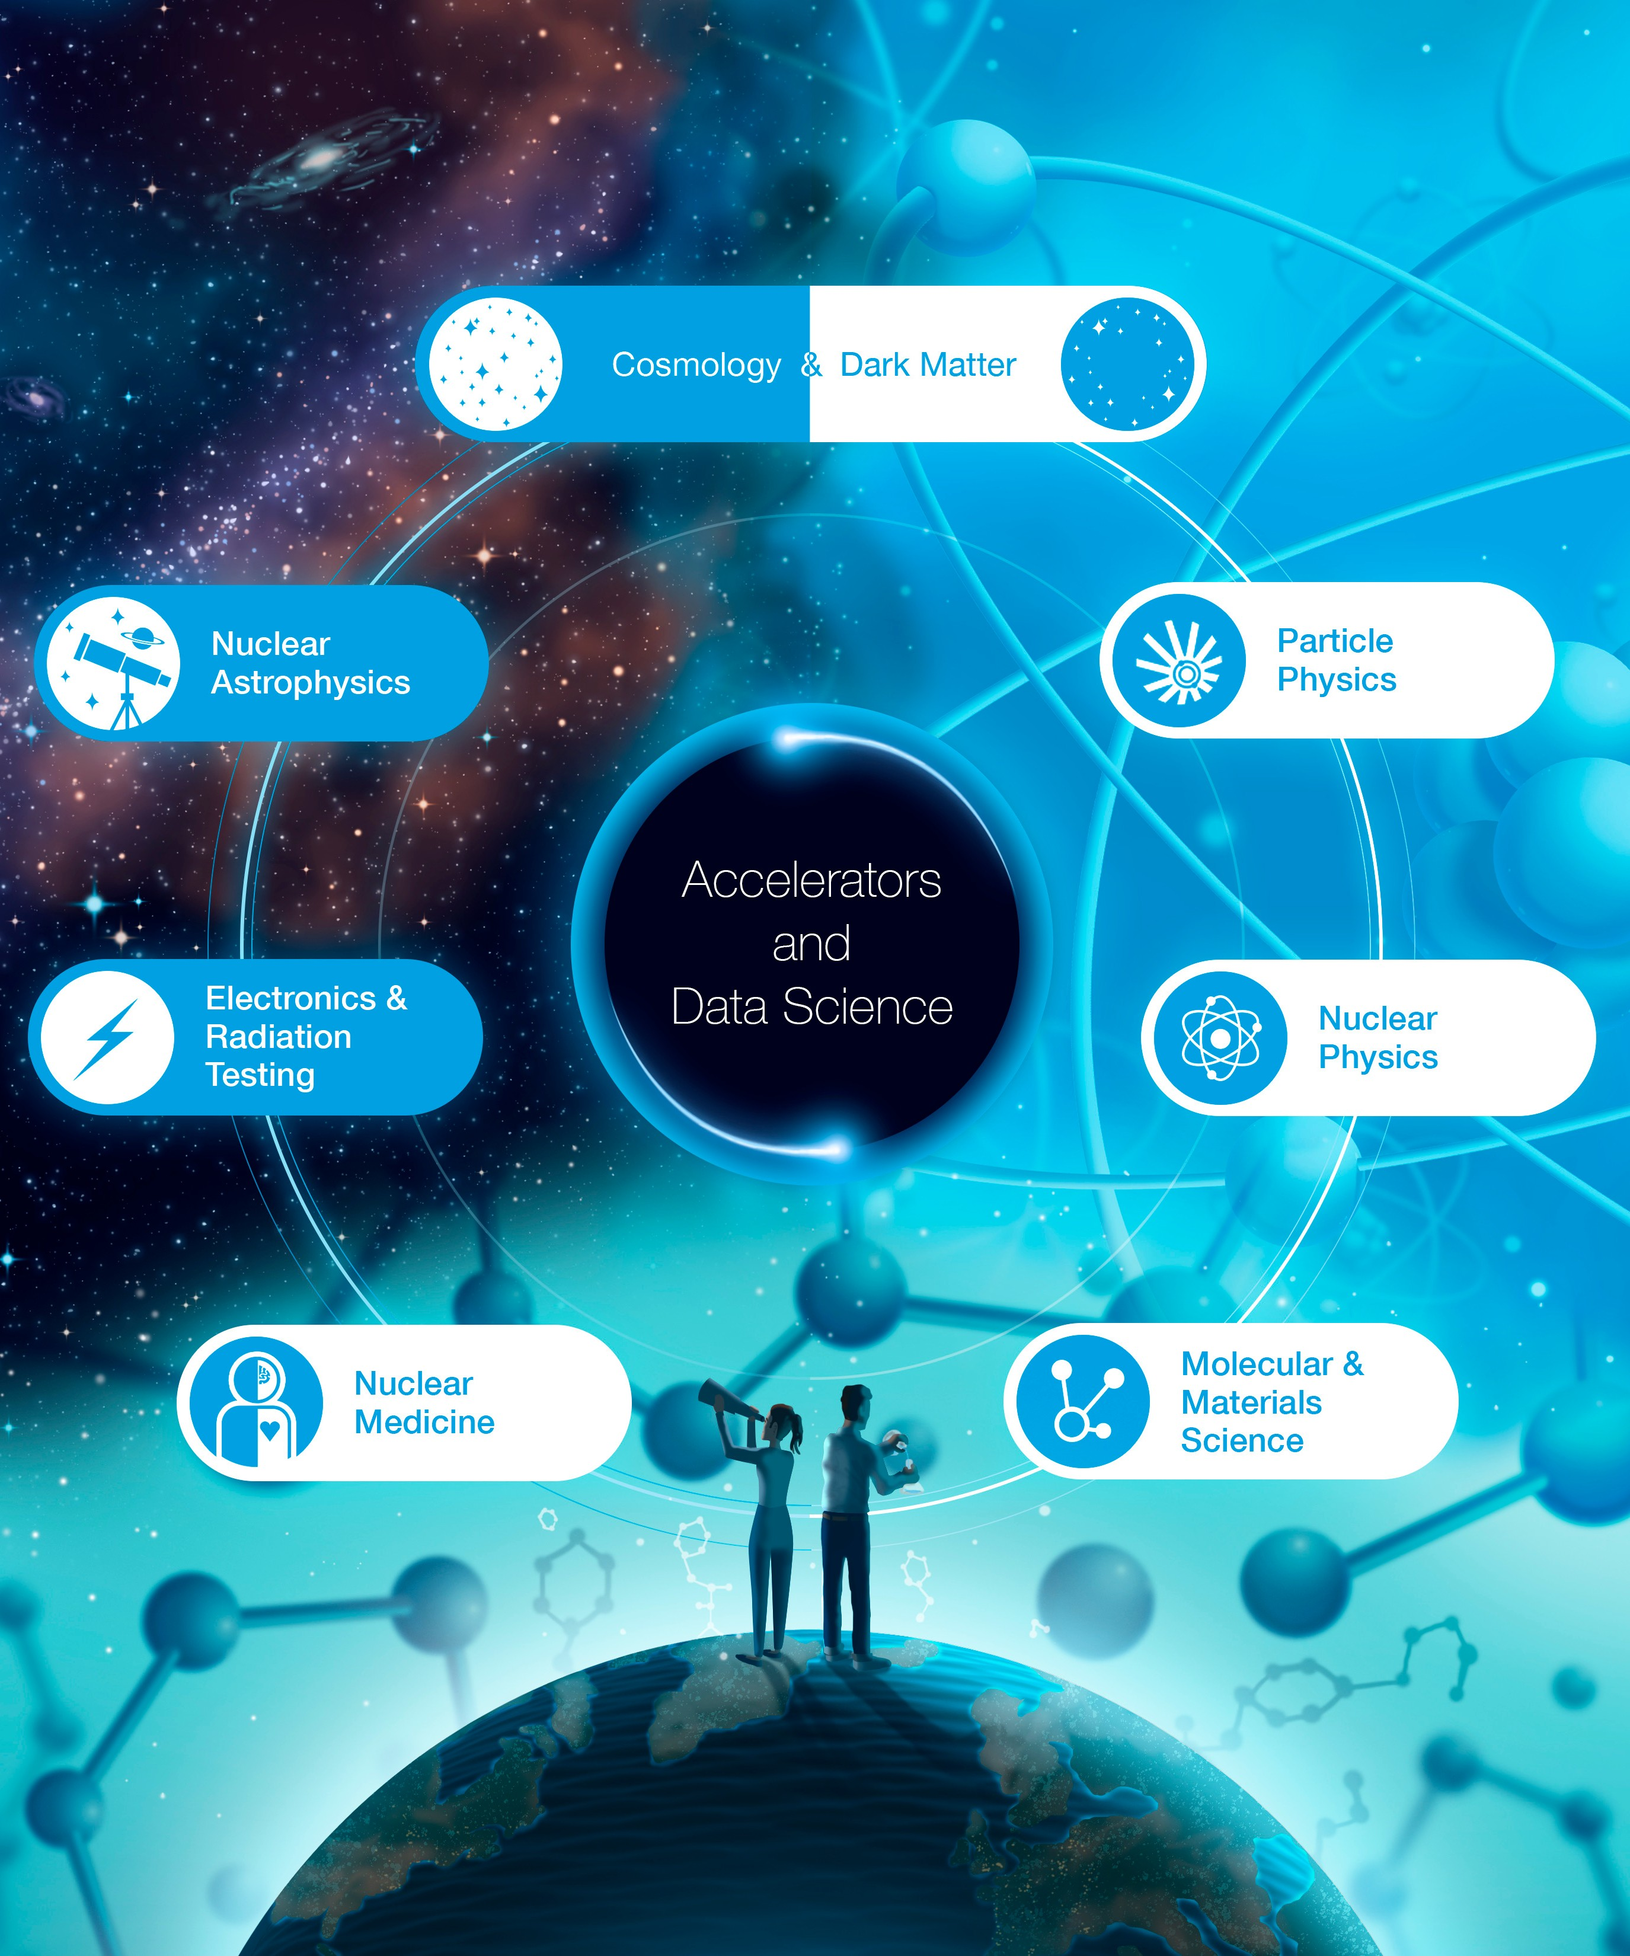






Research with Impact
from the fundamental to the applied
Deepening our understanding of the natural world
Advancing the imaging and treatment of critical diseases
Accelerators Detectors Data Science
Developing new technologies and innovations
Expanding the boundaries of human knowledge
Inspiring and educating the next generation

Slide 8
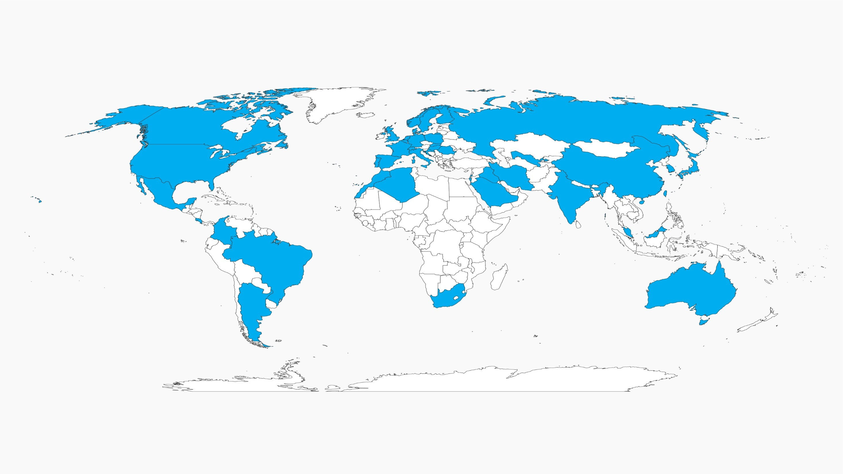
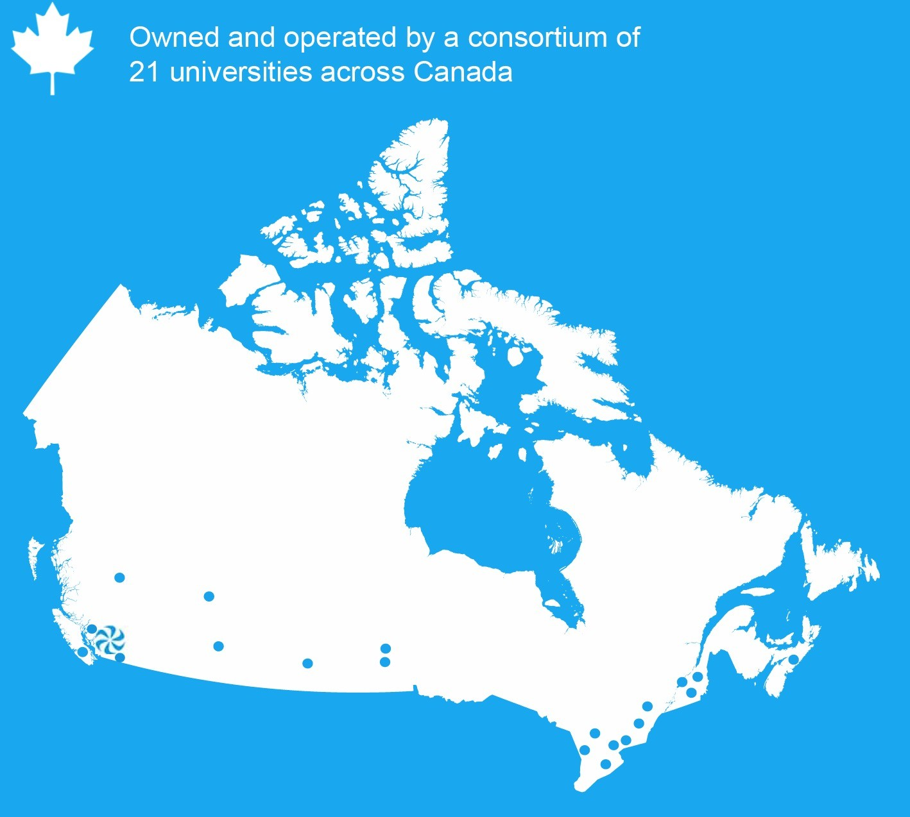

National hub with global reach
TRIUMF’s users comes from over 40 Countries
TRIUMF is a Canadian asset, a point of entry into the international ecosystem of sister laboratories around the world

Slide 9

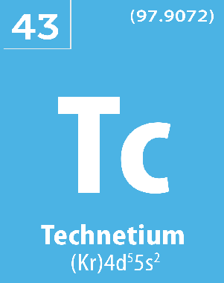
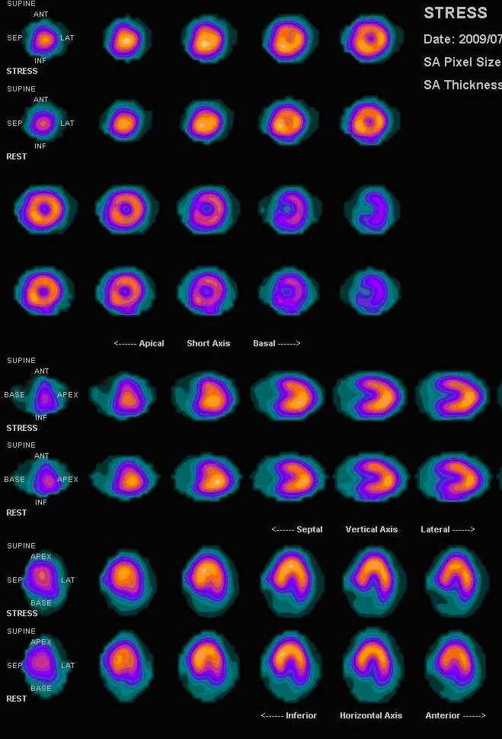


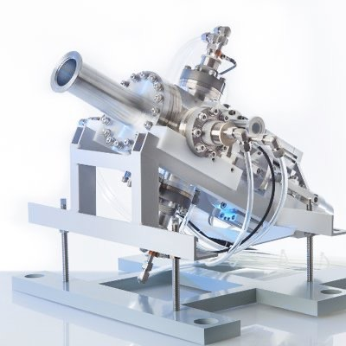




Example: Cyclotron produced Tc-99m
In late 2020, a TRIUMF-led consortium was granted full Health Canada approval for cyclotron-based production of technetium-99m – the world’s most used medical isotope (an alternative to centralized reactor production)
This approval represents a critical milestone for a decade long effort, in response to the 2007 isotope crisis and this technology is the first in the world to obtain such regulatory approval.
ARTMS Inc., a spinoff company resulting from this effort, has successfully raised $25M in global venture funding and is now marketing this technology around the world.
6

Slide 10
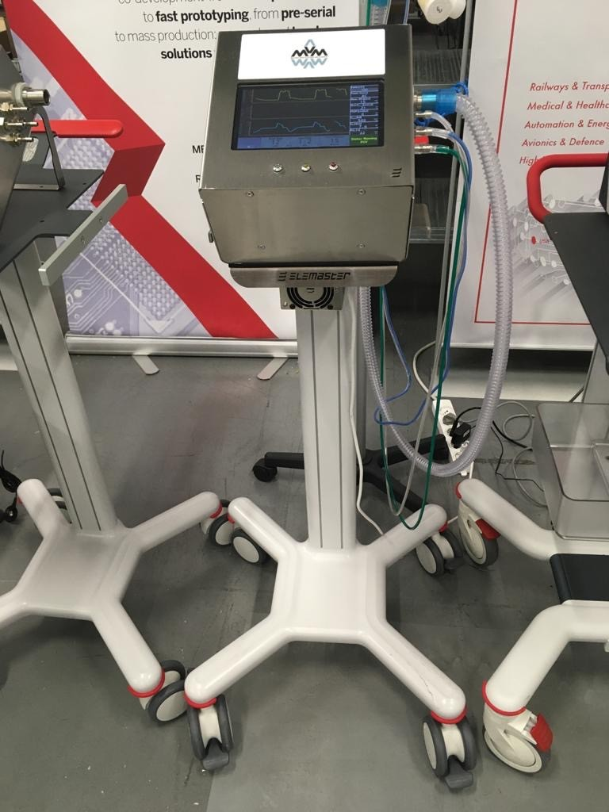
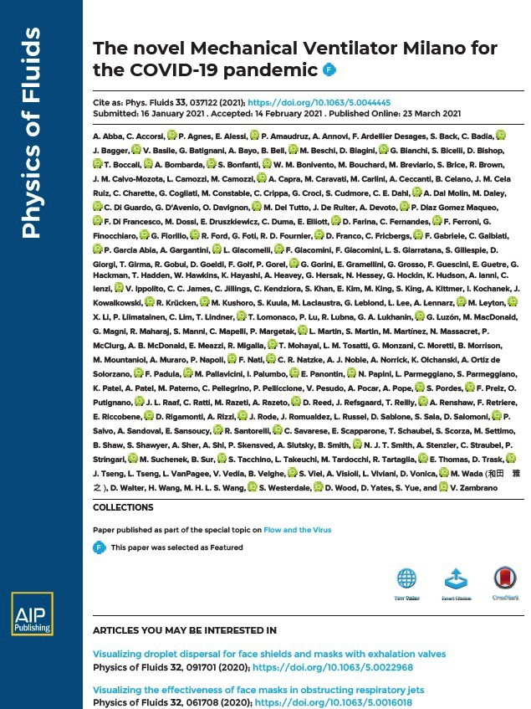
Example: Mechanical Ventilator Milano
Started in Italy by scientists from the Darkside Dark Matter collaboration in response to COVID-19 crisis and ventilator shortage
Conceived as low-cost, reliable, fail-safe, and easy to operate electro-mechanical ventilator for rapid production.
Canadian team led by Nobel Laureate Art McDonald: TRIUMF, Canadian Nuclear Laboratories, SNOLAB, McDonald Institute working with companies Vexos, JMP Solutions
Project started in March 2020 in the midst of the crisis in Italy
Around the clock-effort by ~100 people across 9-time zones
MVM received Health Canada approval in Sept 2020
Government of Canada received 6,000 units from Vexos by March 2021
Demonstration of the power of international collaboration and the readiness of national research infrastructures to address a crisis.
7

Slide 11
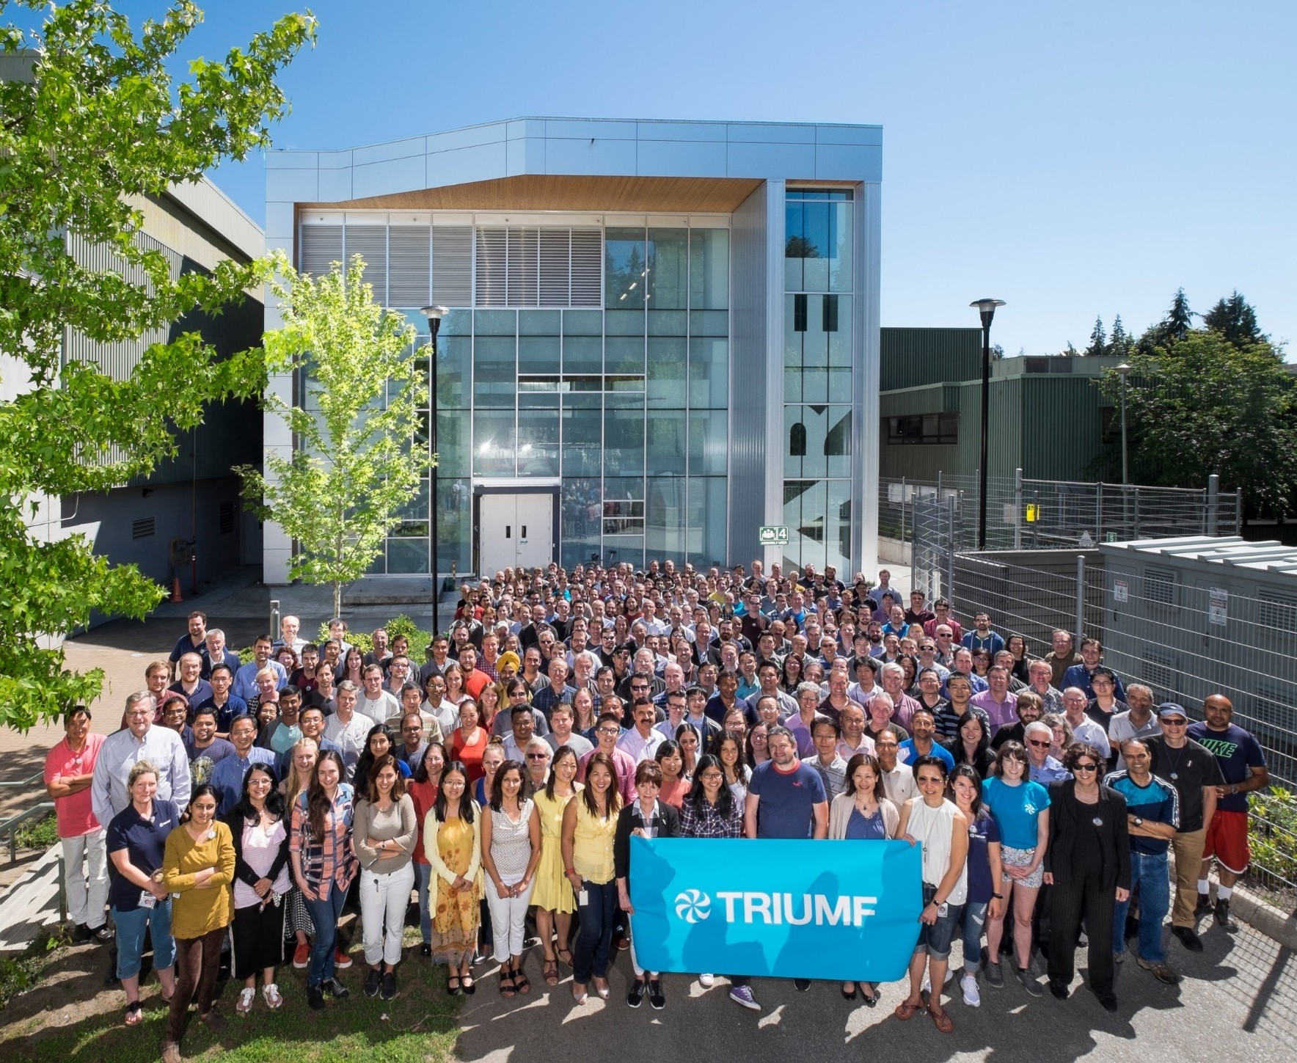



Thank You! Merci!
www.triumf.ca
@TRIUMFLab

Slide 12
Impact of Science
23-25 June, 2021
Adrian Tiplady
Deputy Managing Director: Strategy & Partnerships, South African Radio Astronomy Observatory (SARAO), South Africa
#IOS21

Slide 13
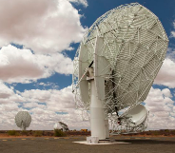
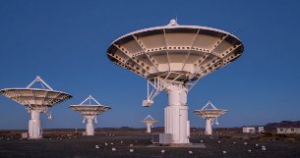
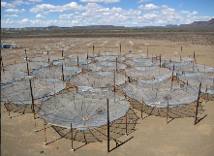
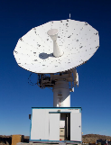
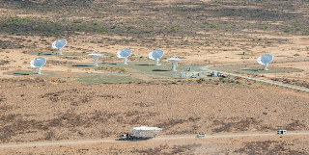
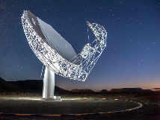
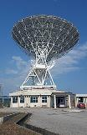

Impact of Science
What infrastructures can facilitate more effective impact of science on society?
AESIS – 23rd June 2021
PRESENTER: Dr. Adrian Tiplady
www.sarao.ac.za
Notes:
Introduction on SARAO
Hisrorically operated HartRAO… has grown with SA’s strategic investments

Slide 14

Greater need for demonstrable societal impact is borne from increased global connectedness
Shareholder Model -> Stakeholder Model

Slide 15
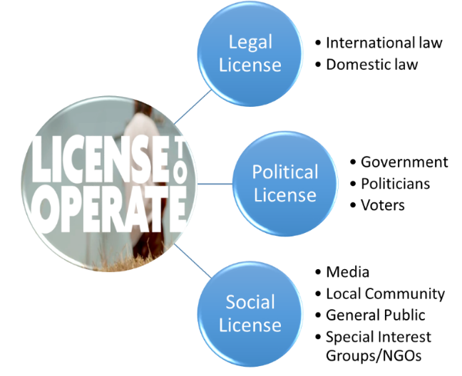
Three Concepts to Reflect Upon…
NSI characterized by orthogonal ‘attributes’
  Research type
  Skills development
  etc.
Output of the NSI is impact, in a variety of forms
  Research impact
  Policy impact
  Socio-economic impact
  etc.
The ‘value chain’ transmits knowledge from ‘low impact’ to ‘high impact’

Slide 16
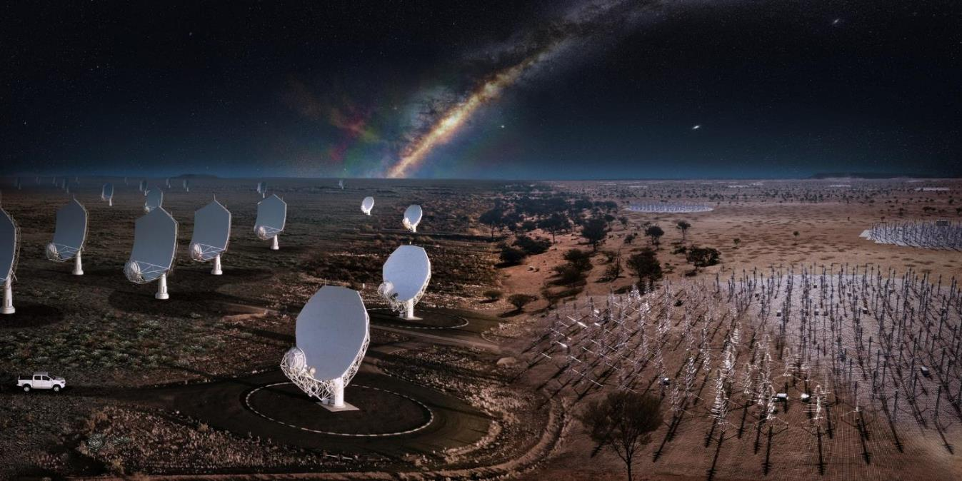
Case for the SKA/MeerKAT – a mega-research infrastructure
Africa
Australia

Slide 17
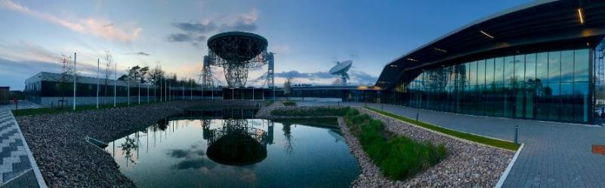

So… what is the SKA?
A Global Endeavour
  Over 1,000 scientists and engineers involved from 20 countries already
  SKA Observatory launched January 2021 – an inter-governmental organisation
    Members: Australia, United Kingdom, South Africa, The Netherlands, China, Portugal, Italy, France
    Observers (planning to become Future Members or Cooperating Parties): Germany, Sweden, India, Japan, South Korea
  Phased deployment
    Phase 1: 1 billion Euro instrument – construction from 2021 - 2027
Global Headquarter (United Kingdom)
Africa
Australia

Slide 18
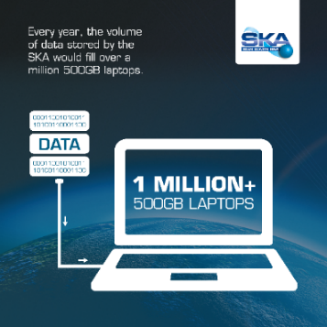
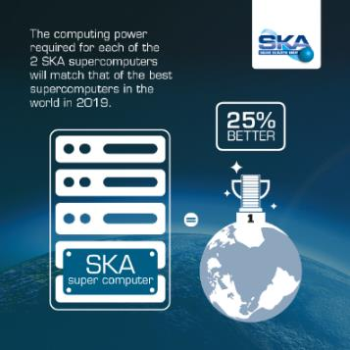
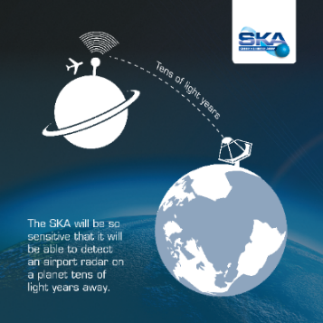
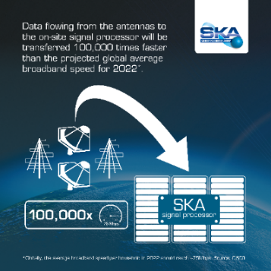
So… what is the SKA?
Vision of the SKA was premised on future technology availability
Next-Generation Technology Machine
  Solving key technology challenges in ‘Big Data’ super-computing, data storage and distribution – extremely relevant for the 4th Industrial Revolution
    SKA1 will generate between 130-300PB per year
  Complex data processing and machine learning

Slide 19
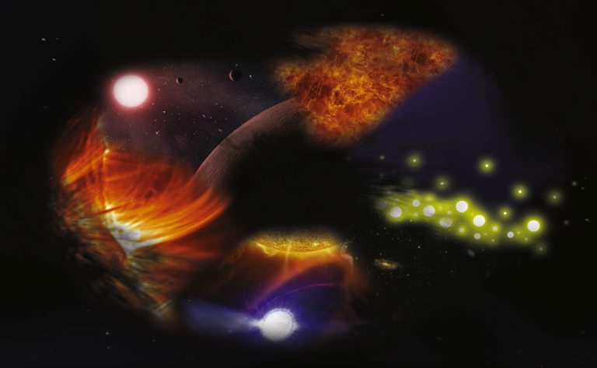
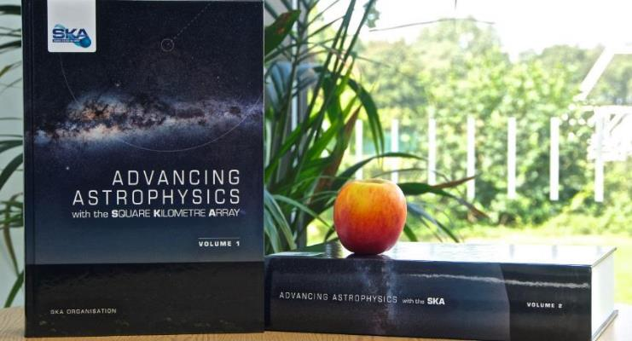
So… what is the SKA?
SKA– Key Science Drivers:
The history of the Universe
Solving fundamental and grand scientific challenges
Cosmic Dawn
(First Stars and Galaxies)
Testing General Relativity
(Strong Regime, Gravitational Waves)
Galaxy Evolution
(Normal Galaxies z~2-3)
Cradle of Life
(Planets, Molecules, SETI)
Cosmology
(Dark Energy, Large Scale Structure)
Cosmic Magnetism
(Origin, Evolution)
Exploration of the Unknown
Extremely broad range of science!

Slide 20
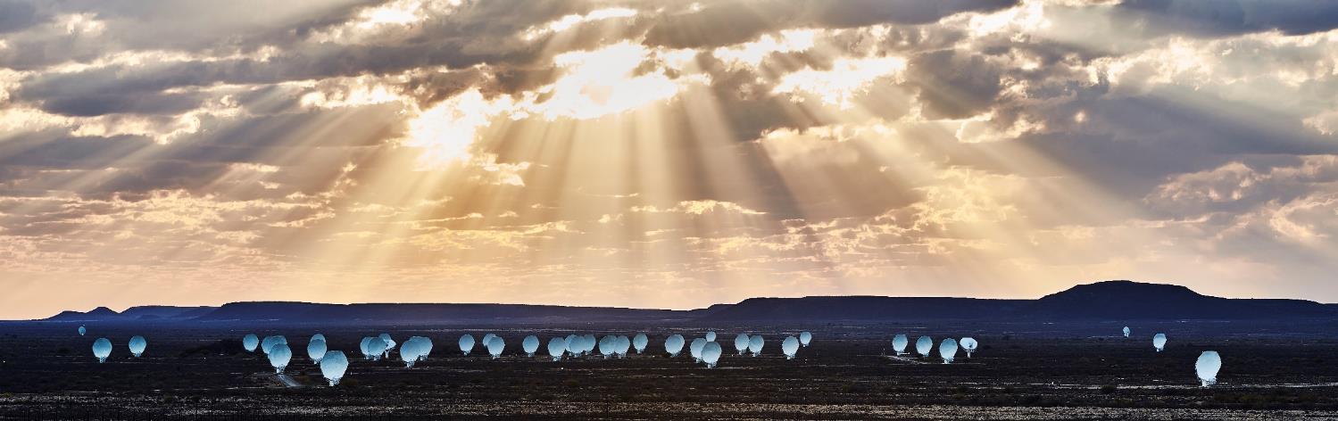
Case for the MeerKAT/SKA
64 x 13.5-metre highly efficient offset Gregorian dishes
Has already delivered high-impact to society through:
      i. Industrial return and advancement
      ii. Reputational enhancement (nationally and internationally)

Slide 21

Clear Impact on Research Enterprise
“The country’s overall output in the index grew by more than 40% in four years, driven by a significant rise in its physical sciences WFC, which jumped from 23.70 in 2012 to 39.31 in 2015. This result reflects South Africa’s strength in astronomy.”

Slide 22
Mind the ‘gap’

Slide 23
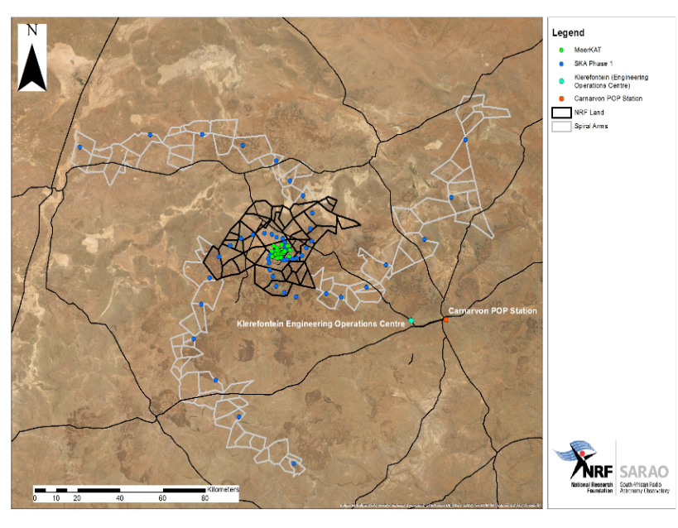

Filling the ‘gap’ – factors that increased impact
Skills Profile
  Skills profile matched needs for high-tech project delivery, consolidated within a single organisation (SARAO)
  Systems thinking approach
Spatial Extent
Directed Interventions
  Human Capital Development
  Corporate Social Investment
  Stakeholder Engagement
  Commercialisation Program
Meerkat
National Park

Slide 24
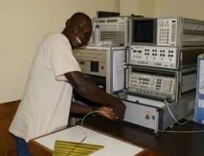
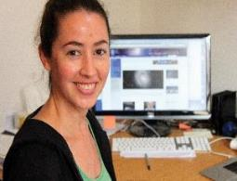
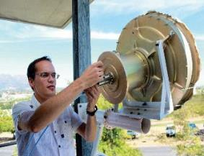
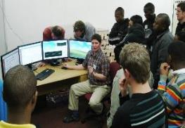
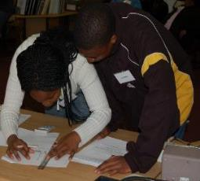
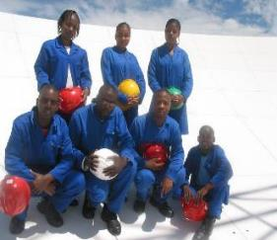
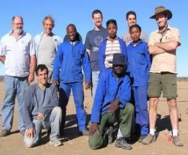
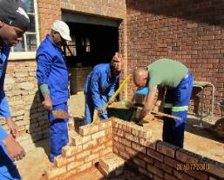
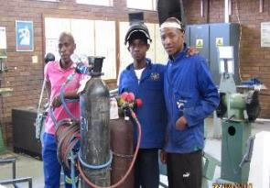
Filling the ‘gap’ – factors that increased impact
Skills Profile
  Skills profile matched needs for high-tech project delivery, consolidated within a single organisation (SARAO)
  Systems thinking approach
Spatial Extent
Directed Interventions
  Human Capital Development
  Corporate Social Investment
  Stakeholder Engagement
  Commercialisation Program

Slide 25
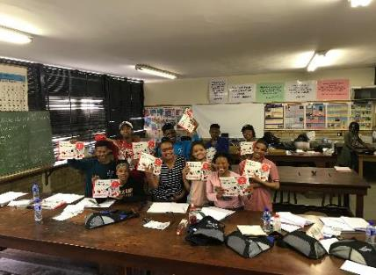
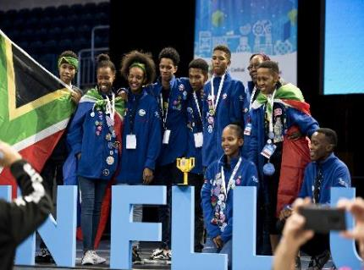
Filling the ‘gap’ – factors that increased impact
Skills Profile
  Skills profile matched needs for high-tech project delivery, consolidated within a single organisation (SARAO)
  Systems thinking approach
Spatial Extent
Directed Interventions
  Human Capital Development
  Corporate Social Investment
  Stakeholder Engagement
  Commercialisation Program

Slide 26
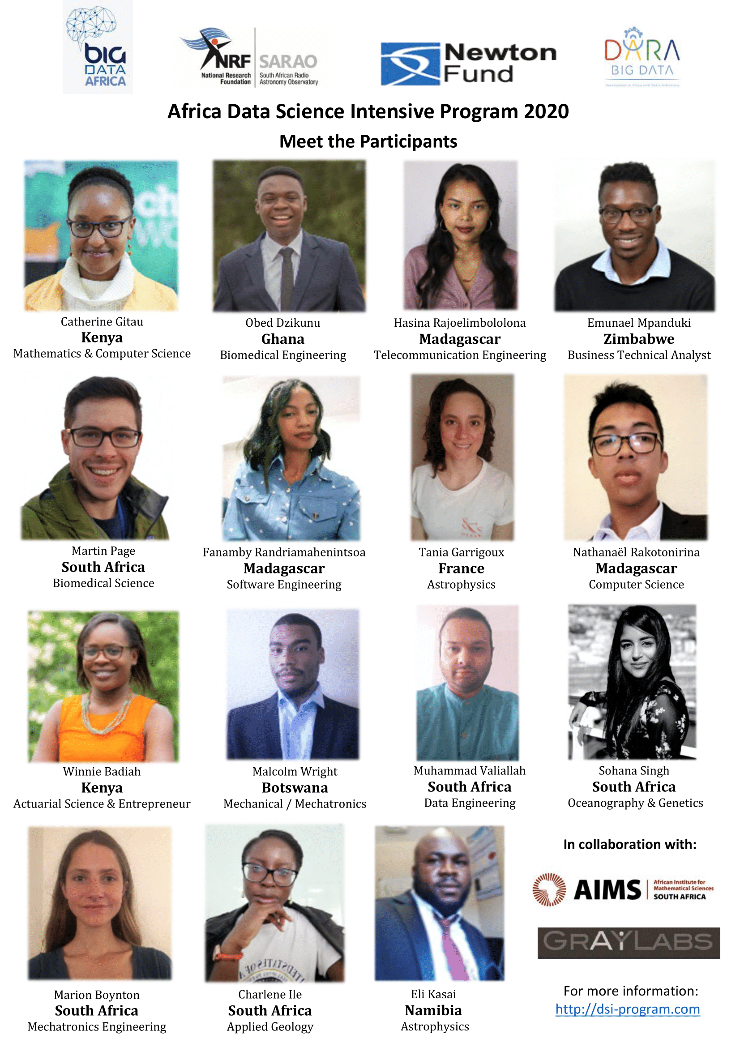
Filling the ‘gap’ – factors that increased impact
Skills Profile
  Skills profile matched needs for high-tech project delivery, consolidated within a single organisation (SARAO)
  Systems thinking approach
Spatial Extent
Directed Interventions
  Human Capital Development
  Corporate Social Investment
  Stakeholder Engagement
  Commercialisation Program

Slide 27
Filling the ‘gap’ – factors that increased impact
Skills Profile
  Skills profile matched needs for high-tech project delivery, consolidated within a single organisation (SARAO)
  Systems thinking approach
Spatial Extent
Directed Interventions
  Human Capital Development
  Corporate Social Investment
  Stakeholder Engagement
  Commercialisation Program
Over 300 subsidized broadband satellite services to farms (owners and workers)
1,303 grants and bursaries awarded by SARAO in STEM
130,000ha national park declared
8,800 local job opportunities created
+ 400 permanent jobs at SARAO
1,252 local women directly employed by SARAO and contractors between 2015 and 2017
Supplier development programs
90% of Karoo staff from local community
R4.7 million in community development initiatives
Artisan training centre established
Knowledge centre established
R2.5 million for training of local community

Slide 28
Filling the ‘gap’ – factors that increased impact
Skills Profile
  Skills profile matched needs for high-tech project delivery, consolidated within a single organisation (SARAO)
  Systems thinking approach
Spatial Extent
Directed Interventions
  Human Capital Development
  Corporate Social Investment
  Stakeholder Engagement
  Commercialisation Program

Slide 29
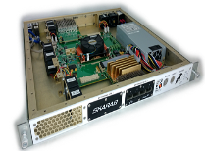
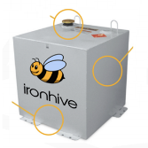
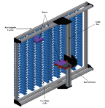
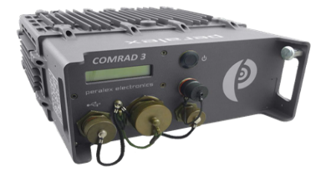
Filling the ‘gap’ – factors that increased impact
Products Developed
Open Source Computing Technologies
  R100m+ saving (storage and data processing) compared to commercial products
SKARAB
  Low cost general computing platform
IRON HIVE
  Low cost, high power efficiency, ruggedized high performance computing platform
TAPE LIBRARY
  High capacity data storage solution at 30% of commercial cost of ownership
COMRAD
  Passive radar solution for aircraft tracking
  Application in border monitoring, anti-poaching
Skills Profile
  Skills profile matched needs for high-tech project delivery, consolidated within a single organisation (SARAO)
  Systems thinking approach
Spatial Extent
Directed Interventions
  Human Capital Development
  Corporate Social Investment
  Stakeholder Engagement
  Commercialisation Program

Slide 30
Serendipity – how the skills profile responded to COVID
Expert skills developed within a basic research infrastructure environment are highly transferable
Response to critical, unexpected challenges
  Growing number of reports, workshops that look at how global research infrastructure has responded to the COVID-19 pandemic
    In South Africa, two basic research communities/entities responded to national needs:
      Particle physics community – modelling of COVID-19 infections
      Radio astronomy – design, development and delivery of CPAP ventilators

Slide 31
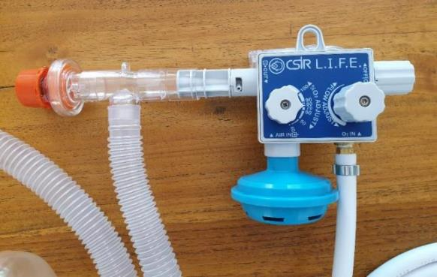
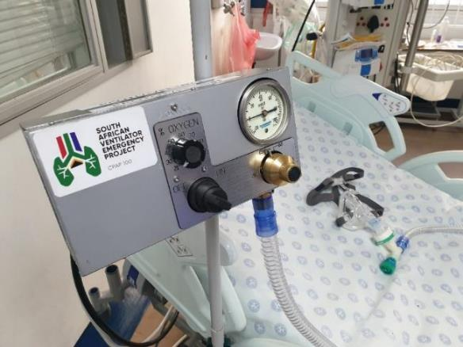
Serendipity – how the skills profile responded to COVID
SARAO appointed by Ministry for Trade and Industry to coordinate and project manage design, manufacture and delivery of 20,000 ventilators in response to COVID-19 pandemic
  Demonstrated history of delivering high-tech projects
  Started April 2020, completed November 2020
Applied rigorous system engineering and quality assurance methodologies, developed and refined during the MeerKAT project, for:
  requirements, specifications, procurement & contract management, design reviews, quality control, deployment
Delivered high-efficacy treatment systems (CPAP ventilators) at low cost (~R12,500 per ventilator = 750 Euros per ventilator)

Slide 32







Serendipity – how the skills profile responded to COVID

Slide 33

Summary
Research infrastructures should recognise the need to own a ‘social license to operate’, and understand their value proposition to a broader sector of society
Research infrastructures shoulder recognise the gaps in the knowledge value chain in which they participate, and implement strategies to ‘fill the gap’ in coordination with other actors, or internally
Dr. Adrian Tiplady
atiplady@ska.ac.za

Slide 34
Impact of Science
23-25 June, 2021
Zeblon Vilakazi
Vice Chancellor of Wits University, South Africa
#IOS21

Slide 35


We are here
Rate of Change
~ 2007
Time
Graph originally by Astro Teller, CEO of Google X, featured in Thomas Freidman’s “Thank you for being late”

Slide 36



What's the cause of this driver of the exponential acceleration
First transistor (1949)
(Brattain-Bardeen Nobel 56)
Z80 microchip
(nano chip)
Size: mm scale (grain of sand)
1000th mm scale (width of human hair)
Size: nm scale (width of DNA strand)
COVID-19: Enabled the fast gene sequencing and drug design at an unprecedented pace

Slide 37




PAC Man ( 1980)
Dr. Gordon MOORE (Intel)
IBM Computer used for Apollo Mission

Slide 38



Slide 39
How did we get here?
Role of mega science & Infrastructure in driving the 20th century

Slide 40


Two major geo-political drivers of mid-20th Century
Manhattan Project -> Nuclear Age Project Apollo/Soyuz -> Space Age
Trinity Test: 1945 (New Mexico)
Saturn V Launch: 1969 (Texas)

Slide 41

Meanwhile on the other side of the Atlantic: on the lake Geneva shoreline
1949 : European science no longer world class (brain drain) to the USA
UNESCO in Paris in December 1951
  first resolution concerning the establishment of a European Council for Nuclear Research (CERN) adopted.
Geneva was selected as the site for the CERN Laboratory at the third session of the provisional council in 1952
Fast forward to 2006: World's largest superconducting magnet switches on at LHC
…now the worlds largest mega science project involving all continents (open science)
2012 : Discovery of Higgs particle – largest peacetime global, non-military project
science sans frontier, science pour paix

Slide 42



Meanwhile on a lake Geneva shoreline
The World Wide Web is a wide-area hypermedia information retrieval initiative aiming to give universal access to a large universe of documents
Screenshot of the recreated page of the first website

Slide 43







CERN/HEP is also: Technology Transfer
Birthplace of the WEB!
Silicon detector for a Compton camera in nuclear medical imaging
Radiography of a bat, recorded with a GEM detector
Medipix: Medical X-ray diagnosis with contrast enhancement and dose reduction

Slide 44


Current issues and the African context
About 0.5% of CERN users are African Nationals
Low participation of African scholars in major research labs around the world. Some examples:
CERN users
Users of LHC experiments
Not limited to CERN.
Broader issue of knowledge inequality
Opportunity: African Youth Bulge and fast growing economies (albeit from low-base) like Asian economies of past decades.

Slide 45








Monday 18 July 2016, Cape Town
MeerKAT AR1 First Light
? Interesting quarted
FR1 radio galaxy
Ex Africa Semper Novi
Star forming galaxy FR2 radio galaxy
More than 1300 individual objects – galaxies in the distant universe – are seen in this image.
Notes:
Presenter
2021-06-21 15:58:22
--------------------------------------------
MeerKAT First Light image. Each white dot represents the intensity of radio waves recorded with 16 dishes of the MeerKAT telescope in the Karoo (when completed, MeerKAT will consist of 64 dishes and associated systems). More than 1300 individual objects – galaxies in the distant universe – are seen in this image.

Slide 46




“First Light is a significant achievement in the lifetime of a project and we congratulate our South African colleagues on this fantastic preliminary result” said Prof. Philip Diamond, Director-General of the SKA Organisation which oversees the delivery of the international SKA project. :“This bodes very well for the science SKA will deliver once the 64 MeerKAT dishes are integrated into the 197-dish SKA array in South Africa”

Slide 47

Gravitational Wave Observatories

Slide 48

Can South Africa host the another Southern Hemisphere Underground Facility?
Status of underground labs
South Africa was active in this area of research in the 1960’s through pioneering experiments done in a gold mine by F. Reines & JPF Sellschop
  observed (in 1965) the first natural neutrinos along with the Indian team led by Goku Menon and colleagues in Kolar Gold fields in India, setting first astrophysical limits!
Some of the World’s deepest mines are in SA:
  Tau Tona 3,900 m (12,800 ft) – 50 C
  Plans to extend Mponeng mine, a sister mine to TauTona, down to 4,500 m (14,800 ft) in the coming years

Slide 49






iThemba: Laboratory Accelerators Based Science
Injector cyclotron 1 Separated sector cyclotron
K11 Cyclotron
cyclotron
3MV Van de Graaff
6MV Tandem
Injector cyclotron 2
15
15

Slide 50



QuantuM sputiK MoMent.
The Economist: Sep 25th 2019

Slide 51

A QUANTUM TECHNOLOGY ROADMAP FOR SOUTH AFRICA : A Quantum
Communication Flagship: building the
(South) African node of the global quantum internet
(A. Forbes et al.)
Developed nations have invested heavily over the past two decades in establishing a vibrant research community studying quantum technology related physics.
Many policy documents on national efforts to develop these technologies have been compiled
Governmental funding in many of these countries have been increasingly funneled toward transforming laboratory successes into marketable technologies according to well- defined roadmaps.
It is clear that a new industry is on the horizon with many opportunities to contribute, ranging from being a full-scale quantum technology manufacturer to a supplier of enabling technologies for international companies

Slide 52



Getting Africa Quantum Ready
Addis Ababa University
University of Ghana
University of Nairobi
University of Lagos
University of Ibadan
Obafemi Awolowo University lle-Ife
University of Rwanda
University Cheikh Anta Diop
University of Cape Town
University of Kwa-Zulu Natal
University of Pretoria
Rhodes University
University of Stellenbosch
University of the Witwatersrand
University of Dar es Salaam
Makerere University

Slide 53
Quantum Future
Quantum computers promise to run calculations far beyond the reach of any conventional supercomputer.
They might revolutionize the discovery of new materials by making it possible to simulate the behaviour of matter down to the atomic level.
Molecular modelling for drug development and treatment plans.
There is even hope they will supercharge artificial intelligence by crunching through data more efficiently.
New industries will be spawned
“The thing driving the hype is the realization that quantum computing is actually real. It is no longer a physicist’s dream—it is an engineer’s nightmare.” Isaac Chuang (MIT)
“Nature is quantum, goddamn it! So if we want to simulate it, we need a quantum computer.”
Richard Feynman; 1965 Physics Nobel Laureate

Slide 54
Impact of Science
23-25 June, 2021
Thank you
#IOS21

